Slide 1
import random
a=0
b=0
c=0
while True:
c+=1
if c>1:
print("press 'yes' to play again or press 'no' to end the game.")
user1=input().lower()
if user1=='yes':
choices=['rock','paper','scissors']
computer=random.choice(choices)
player=input("rock, paper, or scissors?: ").lower()
print("computer: ",computer)
print("player: ",player)
if player==computer:
print("Tie.")
elif (player=='rock' and computer=='paper') or (player=='paper' and computer=='scissors') or (player=='scissors' and computer=='rock'):
a+=1
print("you lose")
elif (player=='rock' and computer=='scissors') or (player=='paper' and computer=='rock') or (player=='scissors' and computer=='paper'):
b+=1
print("you win")
else:
print("please enter a valid input")
elif user1=='no':
print("so the final score is: CPU = {} ; USER = {}".format(a, b))
exit()
else:
print("please mind your input.")
else:
choices = ['rock', 'paper', 'scissors']
computer = random.choice(choices)
player = input("rock, paper, or scissors?: ").lower()
print("computer: ", computer)
print("player: ", player)
if player==computer:
print("Tie.")
elif (player=='rock' and computer=='paper') or (player=='paper' and computer=='scissors') or (player=='scissors' and computer=='rock'):
a+=1
print("you lose")
elif (player=='rock' and computer=='scissors') or (player=='paper' and computer=='rock') or (player=='scissors' and computer=='paper'):
b+=1
print("you win")
else:
print("please enter a valid input")

Slide 2
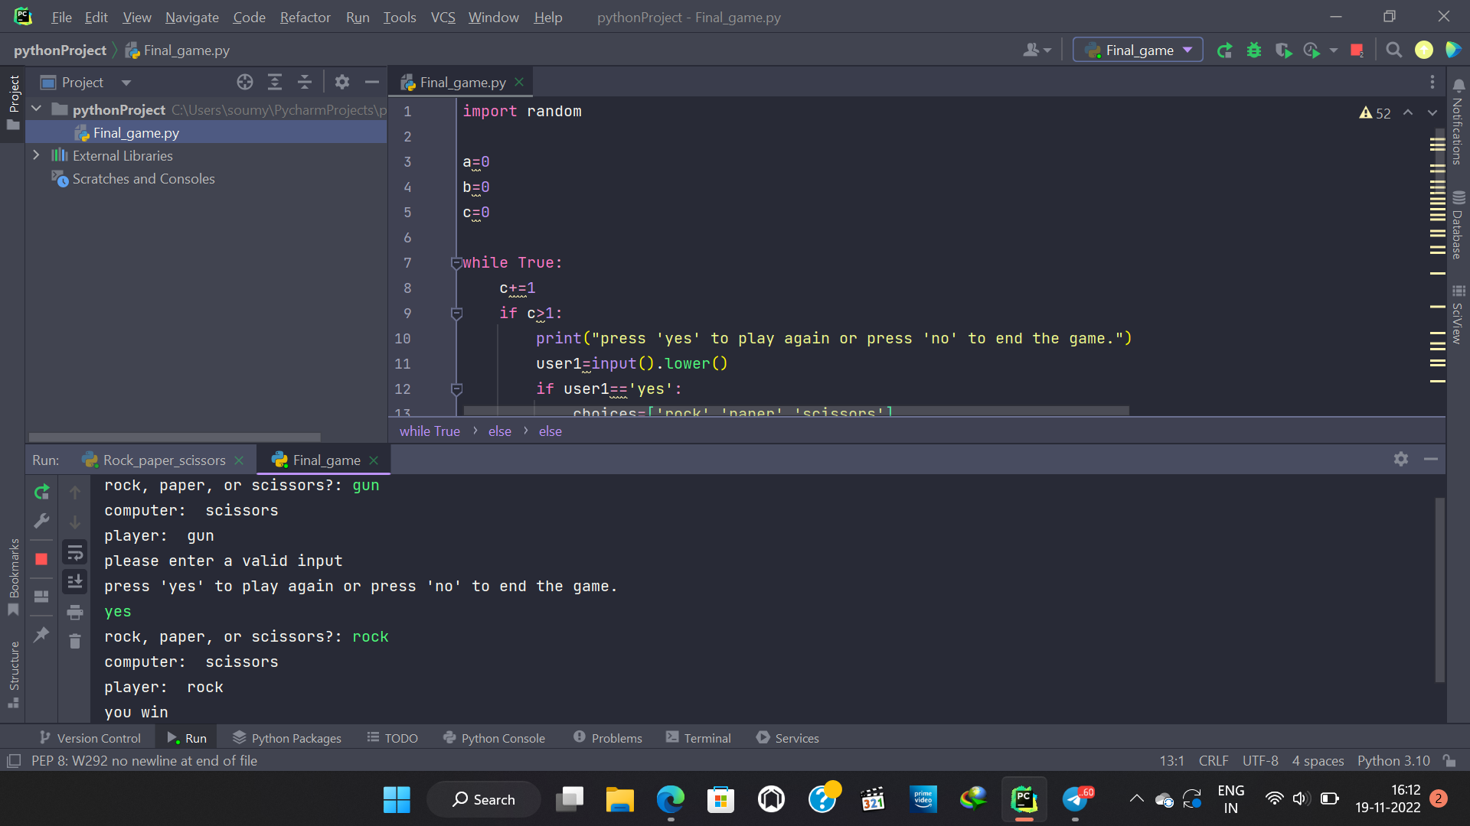

Slide 3
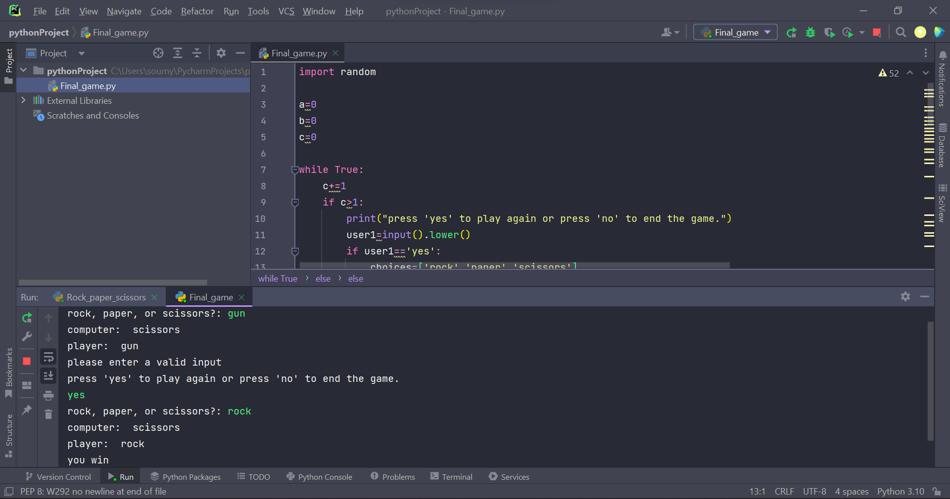

Slide 4
